Slide 1


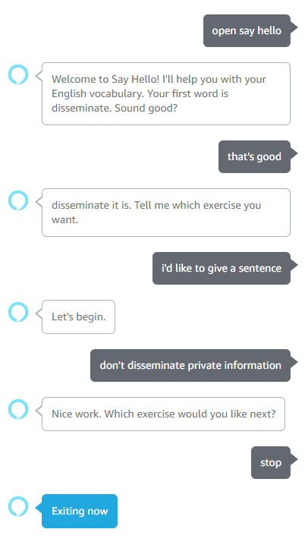
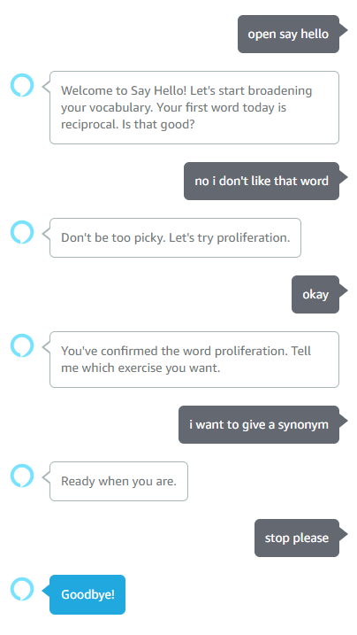

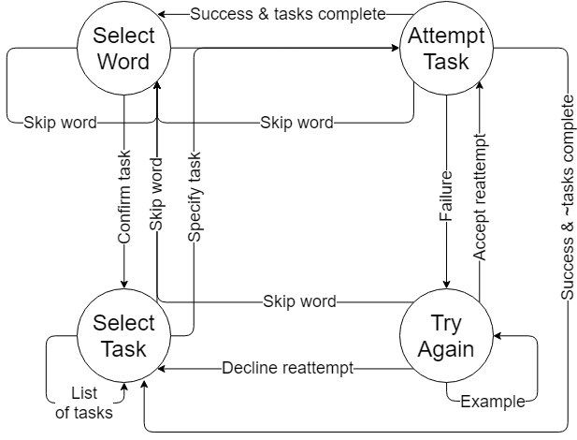
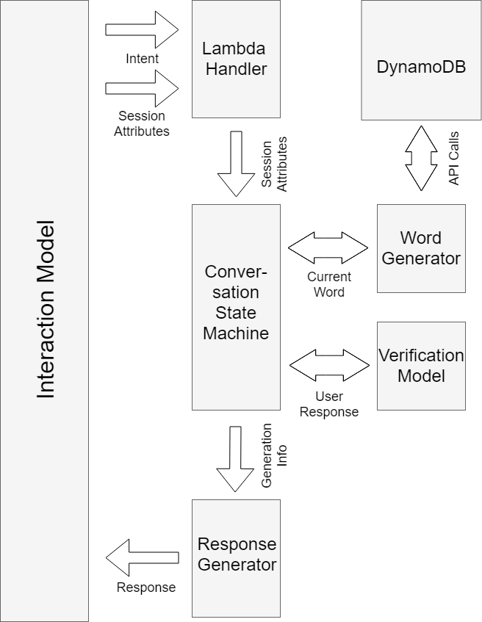
Say Hello!: A conversational system for ESL Learners
Harita Kannan, Mohamad Katanbaf, Dustin Werran, Xiaopei Wu, Qihan Zhao
Introduction
Features
Sample Dialogs
Say Hello is a conversational English vocabulary tutor bot for non-native speakers of English. The goal is to help users build and train English vocabulary through exercises and improve speaking skills through conversational flows.
Target users are students preparing for the TOEFL exam (standardized test measuring English language proficiency) and need training for their vocabulary and conversational skills.
Three different training exercise options:
Definitions
Synonyms
Example Sentences
User tracking memorizes words already visited to prevent repeats
Answer verification provides immediate feedback to user.
Example answers built into model available upon user request.
Contextual help response guides user through the skill.
Retrainable verification model for easy dictionary growth.
Dialog Manager: Conversational FSM
Backend Architecture
Interaction Model
Challenges and Future Work
Built-in Intents | Custom Intents
cancel | Skip word
help | Give an example answer
stop | What are the tasks
no | Specifying a task
yes | Giving an answer to verify
 | Go to next task
 | Agreeing to try again
Flexible to call intents from multiple states
The User Answer slot when user attempts a task works as semi-catchall slot in order to obtain wide array of possible answers.
Challenges:
The Interaction Model presented a variety of technical challenges:
Exercise response had to be general to capture scope of possible inputs, often caught inputs specific to other intents
Intents with single words (yes, no, hello) as example phrases would capture all single-word inputs
Verification Model met following challenges:
Available corpora: TOEFL words are not rare, but uncommon enough to have limited data
Paraphrase identification: extract semantic similarity
Grammar check: capture syntactic and lexical features
Future Work:
Large benefits could be gained with:
More customization in interaction model to handle open-ended inputs
More state-of-the-art verification model such as LSTM
Database
index | word
0 | supplant
1 | disseminate
2 | reciprocal
3 | stereotype
4 | conspicuous
… | …
word | info
supplant | {‘syn’:[replace, override, …], ‘def’:[….], ‘exa’:[….]}
disseminate | {‘syn’:[scatter, disperse, …], ‘def’:[….], ‘exa’:[….]}
reciprocal | {‘syn’:[mutual, shared, …], ‘def’:[….], ‘exa’:[….]}
stereotype | {‘syn’:[standard, pattern, …], ‘def’:[….], ‘exa’:[….]}
conspicuous | {‘syn’:[obvious, clear, …], ‘def’:[….], ‘exa’:[….]}
… | …
user | words
‘amzn1.ask.account.AGZW…’ | [supplant, reciprocal, …]
‘amzn1.ask.account.AHL3…’ | [stereotype, conspicuous, …]
‘amzn1.ask.account.AYNZ…’ | [supplant]
‘amzn1.ask.account.APQN…’ | [disseminate, …]
‘amzn1.ask.account.ARTC…’ | [conspicuous]
… | ...
Notes:
1

